Slide 1
Collegiate Paddling

Slide 2
SAN DIEGO

Slide 3
SaN Diego
Universities in San Diego
Point Loma Nazarene University
University of San Diego
UC San Diego
San Diego State University
Nate Errez (SCKC kayak) is at Point Loma Nazarene University.
Contact him at nateerrez@gmail.com to find about the San Diego collegiate program.

Slide 4
Dalhousie University, Nova Scotia
Azusa Murphy (SCKC canoe) & Miles Cross-White (SCKC kayak) attend.
DM Azusa Murphy on Facebook to ask questions

Slide 5
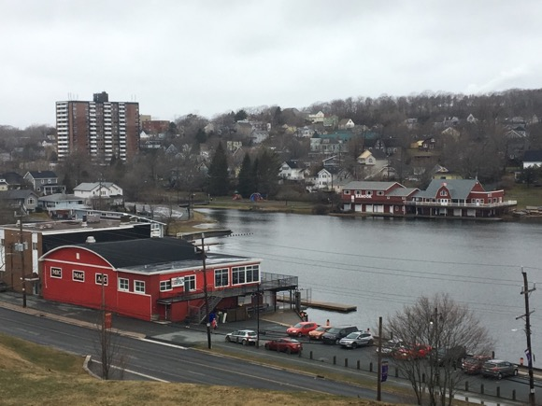
Lake Banook
Clubs on Banook Lake, which is
6km (15min) away from Dalhousie University.
Mic Mac
Banook
Senobe
Senobe
Banook
Mic Mac

Slide 6
University of Victoria, Victoria BC
U Vic
Lydia Keefe Sampson (SCKC canoe) attends and paddles with Nanaimo Canoe and Kayak Club.

Slide 7
University of British Columbia (& Simon FRASER UNIV), VANCOUVER BC
UBC
U Vic
False Creek Racing Canoe Club is 2mi from UBC and has a senior training team. Contact camp coach Diane Tam (False Creek head coach) for info.

Slide 8
LANIER CANOE AND KAYAK CLUB

Slide 9
WASHINGTON CANOE CLUB, Wash. DC
Universities near the boathouse (5-15min)
Georgetown University (the background behind the WCC boathouse)
American University
George Washington University

Slide 10
Oklahoma city
Universities near the boathouse
University of Oklahoma
Oklahoma City University
Embry-Riddle Aeronautical University
Do you have top grades? Univ of OK is known for merit scholarships.

Slide 11
UC IRVINE & CHAPMAN UNIVERSITY
NewPORT, CALIFORNIA
The Newport Aquatic Center (NAC) is next to UC Irvine. Many elite kayakers, canoers, and surf ski paddlers have trained here.
Contact camp coach Michele Eray (Paddle Cal) for information on NAC

Slide 12
Pacific NW
Universities near Tacoma – Paddling club: Gig Harbor
University of Puget Sound
University of WA, Tacoma
Pacific Lutheran University
Universities near Bellingham – Paddling club: Bellingham + large surf ski community
Western WA University
Universities in Seattle - Paddling clubs: SCKC (Seattle), Cascade (Bothell)
University of WA
University of WA, Bothell
Seattle University
Seattle Pacific University
Many community colleges and they are all 4-years

Slide 13
University of WASHINGTON High-Performance Team

Slide 14
UNIVERSITY OF WASHINGTON, Seattle
Questions about UW and paddling while at UW? Contact the panelists at the camp:
Aaron Small (Seattle, SCKC) freshman, undeclared
Andreea Ghizila (Bothel, Cascade) freshman, CS
Evan Truesdale (San Diego, SDCKT) freshman, Engineering
Kenny Kasperbauer (Gig Harbor, GHCKRT) senior, Finance
Wilson Reavley, (Bellingham/SCKC), junior, Design/Industrial Engineering

